Slide 1
ETHICAL HACKING and defense Header Manipulation
2024-2025
Coordinator : Pr. Anass Sebbar
CO-Advisor : Ahmed Didouh
Othmane Cherqi
Student : Ayman Mourtada

Slide 2
TABLE OF CONTENTS
01
04
02
05
06
03
PURPOSE
OBJECTIVES
To identify, demonstrate, and mitigate HTTP header manipulation vulnerabilities with effective defenses
-Identify HTTP header vulnerabilities
-demonstrate attacks
-secure the application
HYPOTHESIS
ANALYSIS
Insecure headers expose web apps to attacks, while secure headers mitigate risks
Clickjacking
X-Forwarded , MITM
Mitigation Strategies
METHODOLOGY
CONCLUSIONS
-Vulnerable App Development
-Attack Demonstration
-Defense Implementation

Slide 3
INTRODUCTION
In today’s digital landscape, web applications are essential but vulnerable to cyberattacks, particularly through HTTP header manipulation, which enables attacks like Host Header Manipulation, clickjacking, MITM, and XSS. This project investigates these vulnerabilities, demonstrates how attackers exploit them, and implements robust defenses to secure web applications.

Slide 4

PURPOSE
Identify Demonstrate Mitigate
HTTP header
Manipulation vulnerabilities

Slide 5
PURPOSE STATEMENT
Identify
Demonstrate
Mitigate
Uncover vulnerabilities in HTTP header configurations that expose web apps to attacks like Host Header Manipulation, clickjacking, and XSS
Show real-world exploitation techniques, such as Clickjacking , MITM , using a vulnerable Flask-based web application.
Implement and evaluate robust defenses, including secure HTTP headers and proper validation mechanisms, to protect against attacks

Slide 6
Key Statistics on HTTP Header Vulnerabilities
11,879,41
18,923,35
Host Header Manipulation
Clickjacking
5,589,23
2,173,78
Data Breaches
Financial Losses

Slide 7
HYPOTHESIS
HYPOTHESIS 1
HYPOTHESIS 2
Insecure HTTP headers make web apps vulnerable to attacks like Host Header Manipulation and XSS.
Secure headers (X-Frame-Options, CSP) reduce the risk of header manipulation attacks
HYPOTHESIS 3
Proper header validation and domain whitelisting prevent phishing and SSRF exploits

Slide 8
METHODOLOGY
Vulnerable Web Application
Secure Application
Test Attacks
Conducted Host Header Manipulation, clickjacking, and MITM attacks
Implemented Flask-Talisman for security headers and HTTPS enforcement.
Developed a Flask-based web app with intentional vulnerabilities

Slide 9
CURRENT SITUATION & PROBLEMS STATEMENT
Vulnerable Web App
Web applications are targeted by cyberattacks, with HTTP header manipulation being a critical vulnerability
WHAT
WHY
Impact
Attackers exploit insecure HTTP headers to redirect users, inject scripts, or steal data
Misconfigured headers and lack of validation mechanisms make applications vulnerable
vulnerabilities can lead to data breaches, financial losses, and damage to user trust

Slide 10
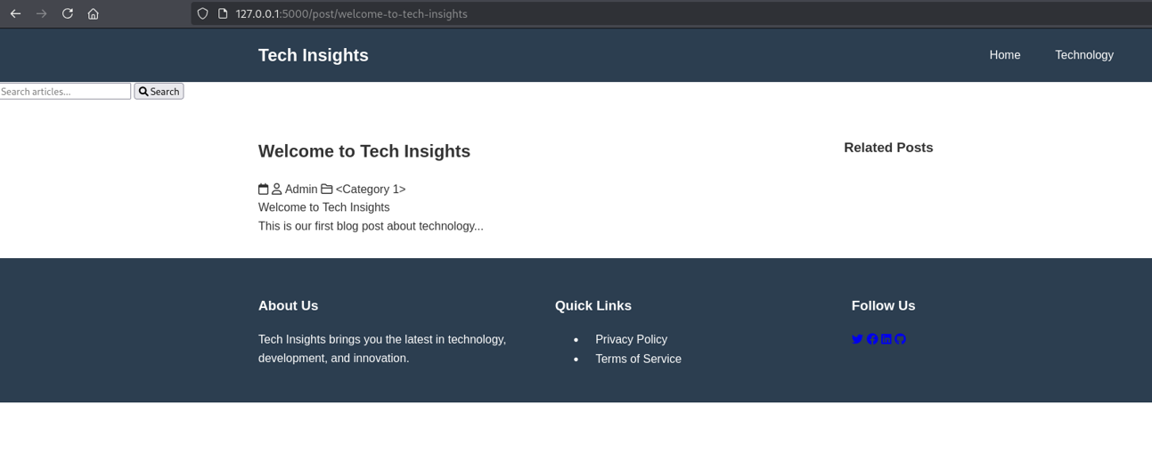
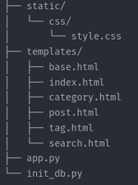
Vulnerable Web App

Slide 11

A PICTURE IS WORTH A THOUSAND WORDS

Slide 12
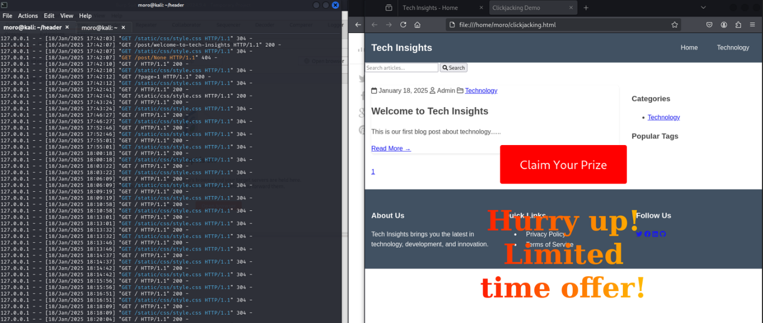
Attack Implementation

Slide 13
Web App Security
Flask-Talisman Integration
Implemented Flask-Talisman to enforce security headers like CSP, X-Frame-Options
Custom Security Headers
Added headers like X-XSS-Protection, Referrer-Policy, and Permissions-Policy
Clickjacking Protection
Set X-Frame-Options: DENY and CSP: frame-ancestors 'none' to block clickjacking.

Slide 14
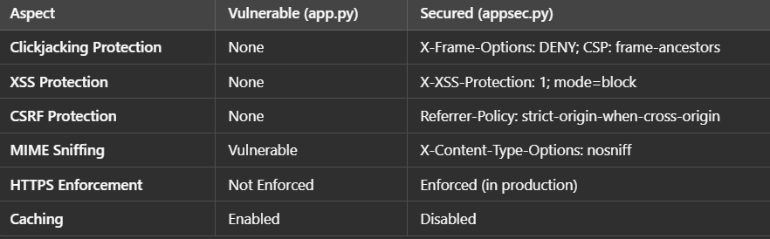
Comparison of Vulnerable vs. Secured Web Application

Slide 15
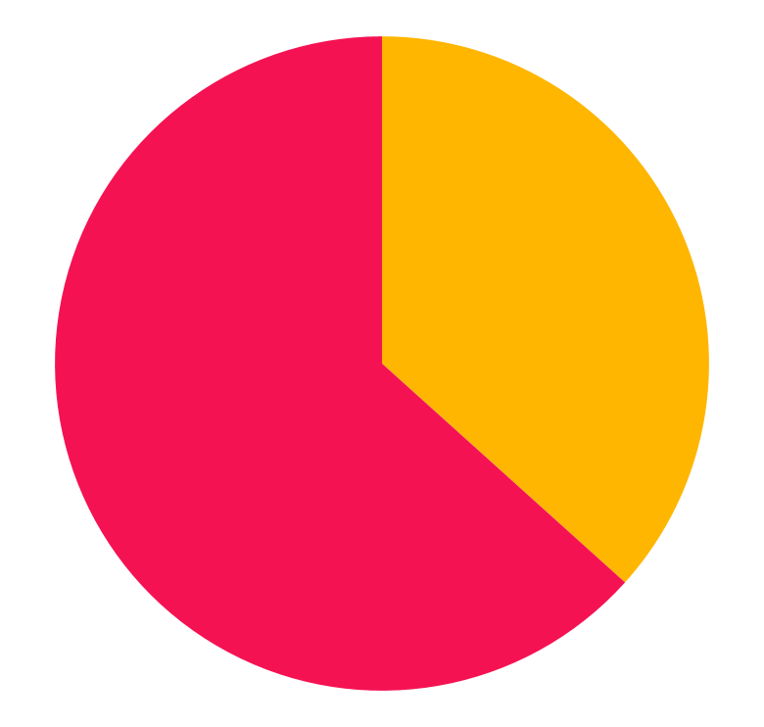
Effectiveness of Security Headers
36%
Appsec.py
64%
App.py
X-Frame-Options : DENY
100% clickjacking
Content-Security-Policy
95% XSS
Content-Security-Policy
80% data leakage
Strict-Transport-Security
100% MITM

Slide 16
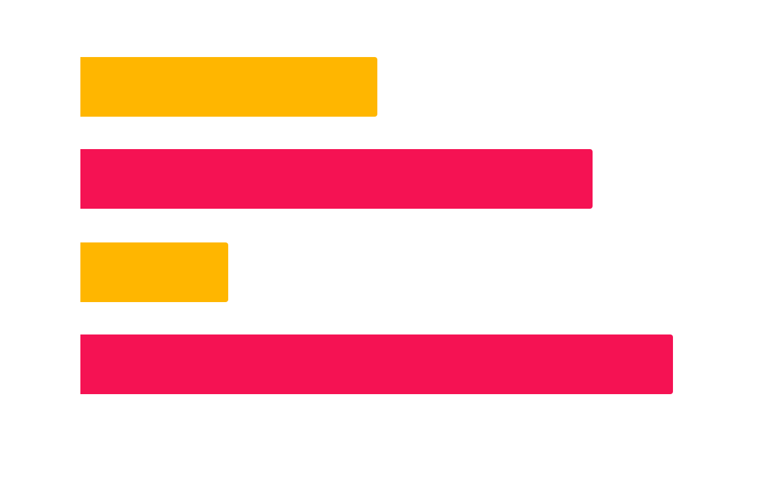
Security Header Effectiveness
X-XSS-Protection
Strict-Transport-Security
X-Content-Type-Options
X-Frame-Options

Slide 17
TIMELINE
01
02
03
04
Defense Implementation
Attack Testing
Final Evaluation
Vulnerable Web Application

Slide 18
Conclusion
SUMMARY
01
Proper configuration of HTTP headers is crucial for web security
This project exposed the dangers of HTTP header manipulation, showcasing attacks like Host Header Manipulation, clickjacking, and XSS on a vulnerable Flask app. Using Flask-Talisman, we enforced secure headers ( X-Frame-Options, CSP, HSTS) to block these attacks. The results prove that secure coding, proper header validation, and regular security checks are vital for defending web applications. Securing headers is a must for building safe, reliable, and trustworthy web systems
Implementing secure headers significantly reduces the risk of attacks.
02
03
Regular security audits and secure coding practices are essential.

Slide 19

REFERENCES
OWASP CSRF Prevention Cheat Wireshark: https://www.wireshark.org/
OWASP ZAP: https://www.zaproxy.org/
Flask Documentation: https://flask.palletsprojects.com/
Flask-Talisman Documentation: https://flask-talisman.readthedocs.io/
Flask-Security Documentation: https://flask-security.readthedocs.io/
Google Web Fundamentals: Security: https://web.dev/security/
HTTP Host Header Attacks: https://portswigger.net/web-security/host-header
Mozilla Observatory: https://observatory.mozilla.org/
SecurityHeaders.com: https://securityheaders.com/
CSP Evaluator: https://csp-evaluator.withgoogle.com/

Slide 20

DOES ANYONE HAVE ANY QUESTIONS?
MOURTADA AYMAN

